Slide 1
Decision Tree Modeling in R: Example
DARTH workgroup

Slide 2
Decision Tree Example
Viral encephalitis can be caused by herpes virus (HVE) or other viruses (OVE)
Pr(HVE) = 52%
Untreated HVE has 71% risk of complications; for OVE the figure is 1%
For HVE, the drug vidarabine decreases risk of complications from 71% to 36%
For OVE, vidarabine side effects increase risk of complications from 1% to 20%

Slide 3
Decision Tree Example
Health outcomes measured as remaining quality-adjusted life-years (QALYs)
Without complications: 20 QALYs
With complications: 19 QALYs
Death (due to biopsy): 0 QALYs
One-time loss of 0.01 QALYs from biopsy

Slide 4
Decision Tree Example
Cost of VE medical care, treatment, and diagnostics
Medical care without complications: $1,200
Medical care with complications: $9,000
Vidarabine: $9,500
Biopsy: $25,000
Remaining lifetime costs
Without complications: $50,000
With complications: $60,000

Slide 5
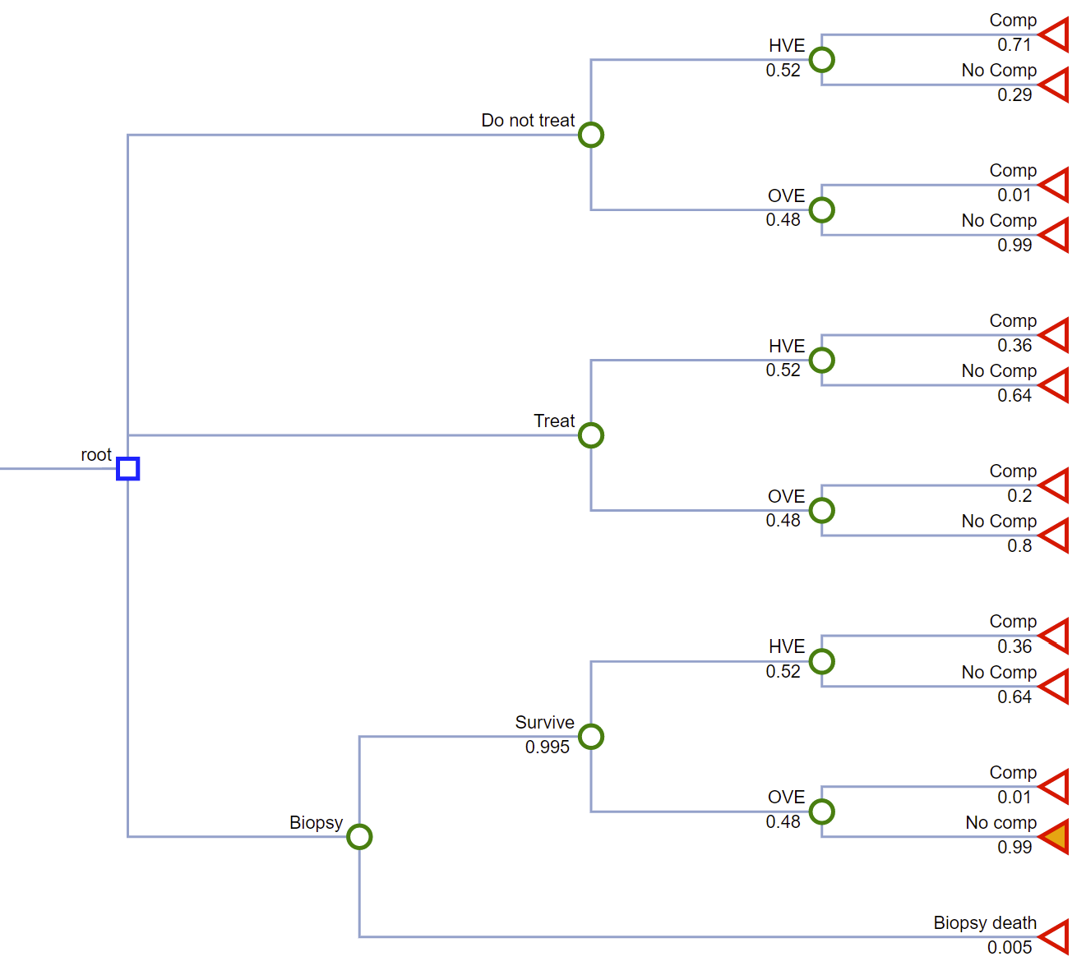

Slide 6
19 QALYs
20 QALYs
19 QALYs
20 QALYs
19 QALYs
20 QALYs
19 QALYs
20 QALYs
18.99 QALYs
19.99 QALYs
18.99 QALYs
19.99 QALYs
0 QALYs

Slide 7
$9,000 + $60,000
$1,200 + $50,000
$9,000 + $60,000
$1,200 + $50,000
$9,000 + $9,500 + $60,000
$1,200 + $9,500 + $50,000
$9,000 + $9,500 + $60,000
$1,200 + $9,500 + $50,000
$25,000 + $9,000 + $9,500 + $60,000
$25,000 + $1,200 + $9,500 + $50,000
$25,000 + $9,000 + $60,000
$25,000 + $1,200 + $50,000
$25,000

Slide 8
Table of Input Parameters
Parameter | Variable Name | Value
Prevalence of HVE | p_HVE | 0.52
Probability of complications without treatment
HVE | p_HVE_comp | 0.71
OVE | p_OVE_comp | 0.01
Probability of complications with vidarabine treatment
HVE | p_HVE_comp_tx | 0.36
OVE | p_OVE_comp_tx | 0.20
Probability of complications due to brain biopsy | p_biopsy_comp | 0.05

Slide 9
Table of Input Parameters
Parameter | Variable Name | Value
QALYs
Remaining QALYs without complications | q_VE | 20
Remaining QALYs with complications | q_VE_comp | 19
Remaining QALYs if died during biopsy | q_death_biopsy | 0
One-time QALY loss due to biopsy | q_loss_biopsy | 0.01
Costs
Medical care without complications | c_VE | 1,200
Medical care with complications | c_VE_comp | 9,000
Vidarabine | c_tx | 9,500
Biopsy | c_biopsy | 25,000
Lifetime without complications | c_lifetime | 50,000
Lifetime with complications | c_lifetime_comp | 60,000

Slide 10
R Session
Notes:
Part 1 = Showing code 3 state model
Part 2 = Exercise build Sick-Sicker model
Part 3 = Show answers of Sick-Sicker

